Slide 1
Credit Card Fraud Detection
Filipe do Vale Melo
CBPF

Slide 2
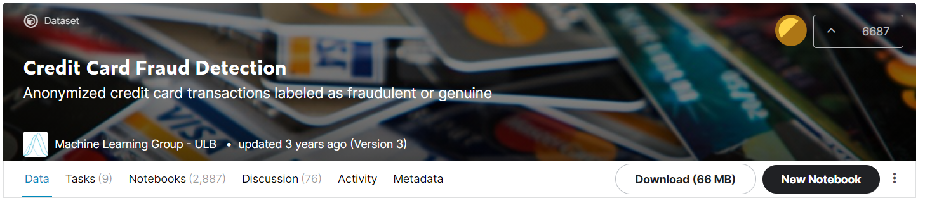
Introduction
The datasets contains transactions made by credit cards in September 2013 by european cardholders.
The goal is to identify fraudulent transactions.
The principal feature of this dataset is the imbalance between the classes: less than 0.2% of the dataset consists of fraudulent transactions.

Slide 3
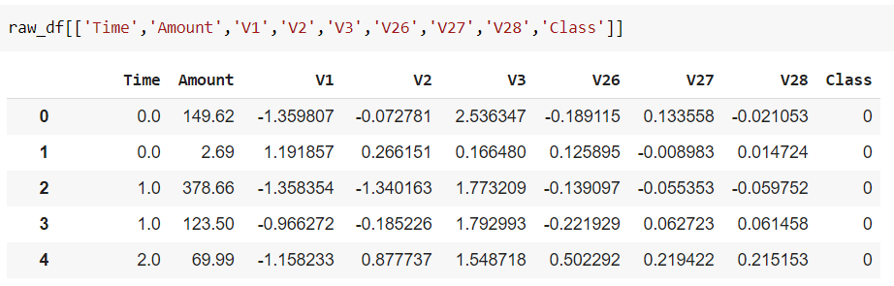
Dataset

Slide 4
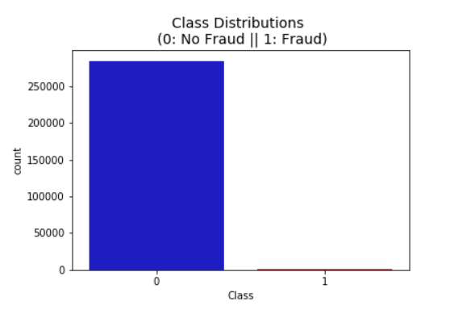
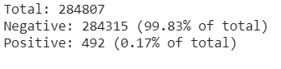
Dataset

Slide 5
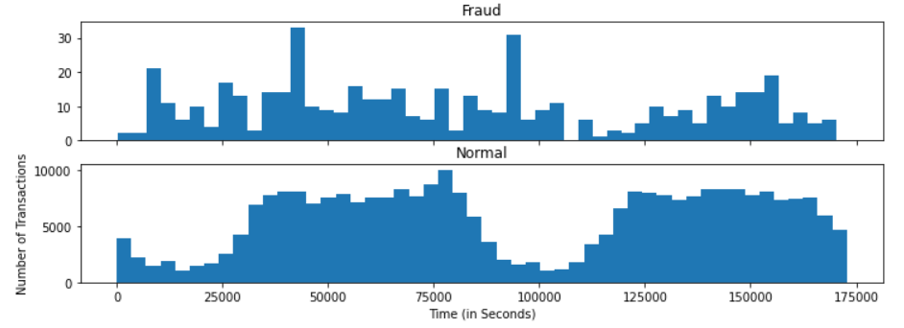
Exploratory Data Analysis (EDA)

Slide 6
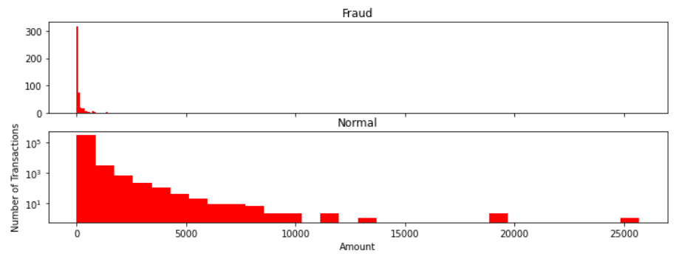
Exploratory Data Analysis (EDA)

Slide 7
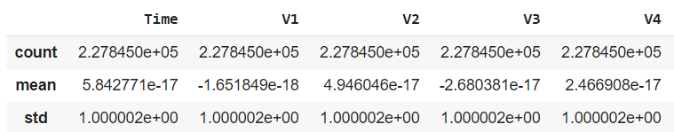
Standard Scaling

Slide 8
Solution proposals
We are going to test three approaches to this problem:
An approach that, during the training, does not take into account the fact that the dataset is imbalanced (baseline model).
An approach that applies weights to the fraud samples.
An approach trained with a dataset undersampled with the non-fraud samples in the dataset.
We will compare the three approaches, plotting the confusion matrices (and measure precision and recall) and ROC/AUC to see which one performs better.

Slide 9
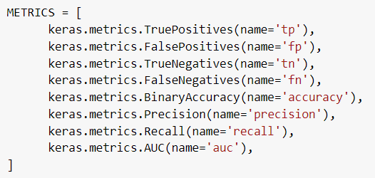
Metrics

Slide 10
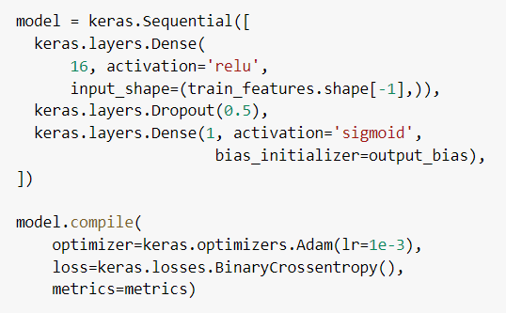
Neural Network Architecture

Slide 11
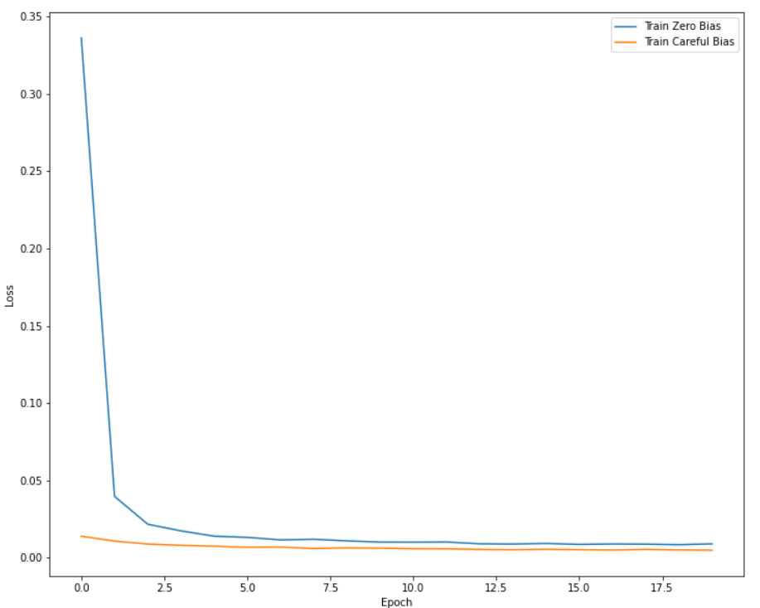
Bias Initialization
In the the approaches with the unbalanced datasets, a careful bias initialization was used.

Slide 12
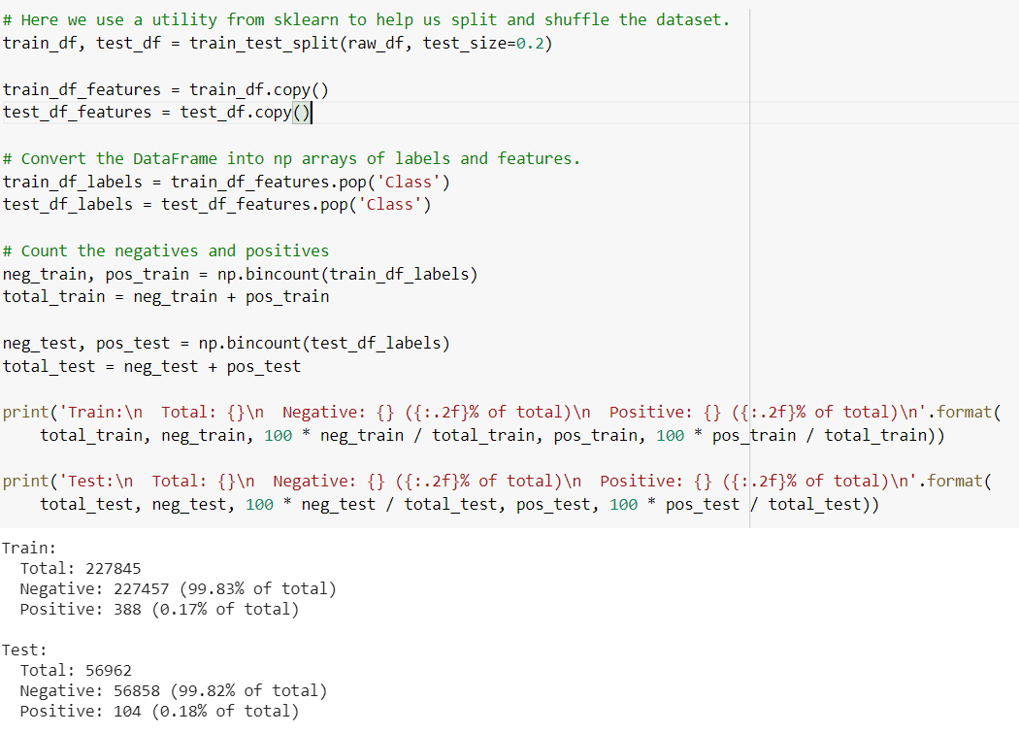
Baseline Model: Train-Test Split

Slide 13
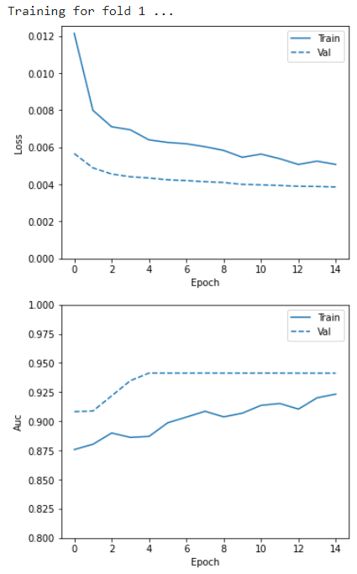
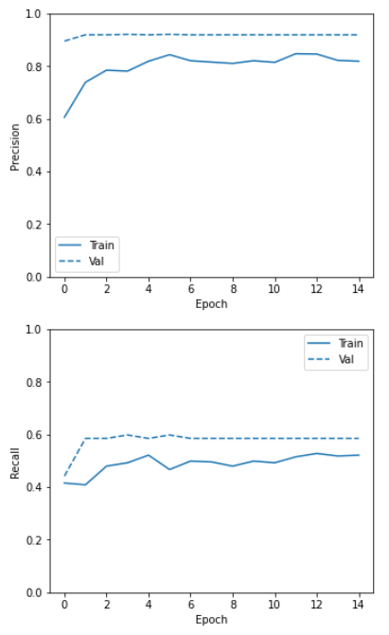
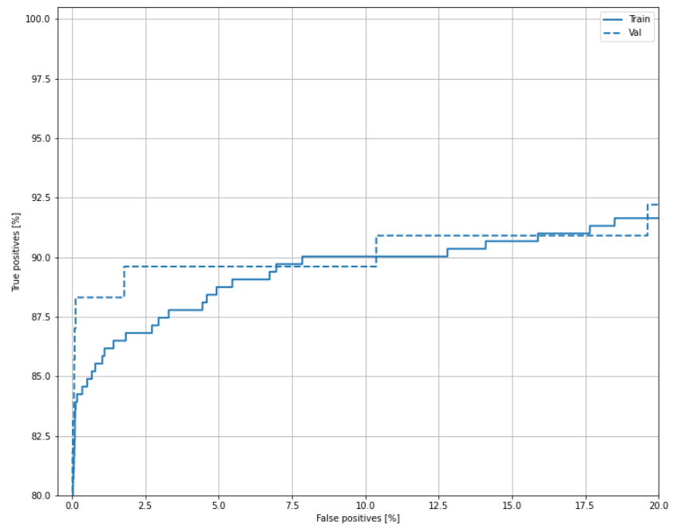
Baseline model: Cross Validation

Slide 14
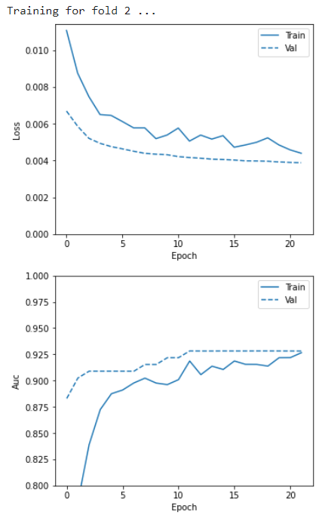
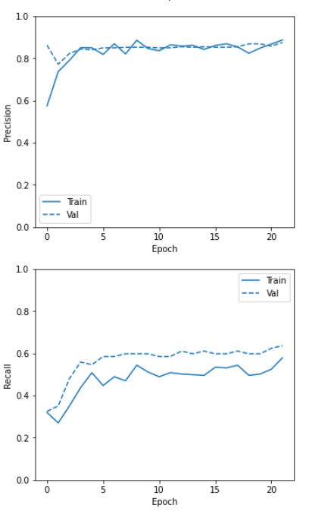
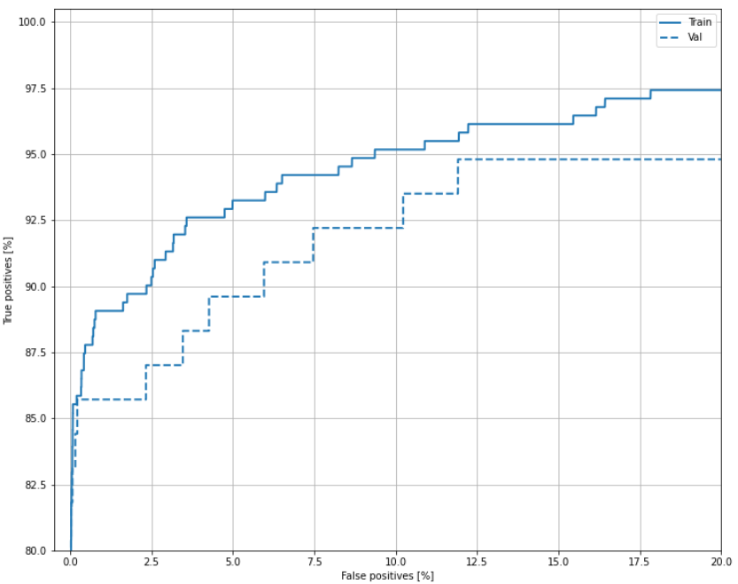
Baseline model: Cross Validation

Slide 15
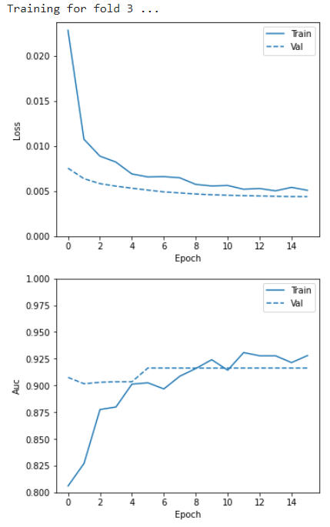
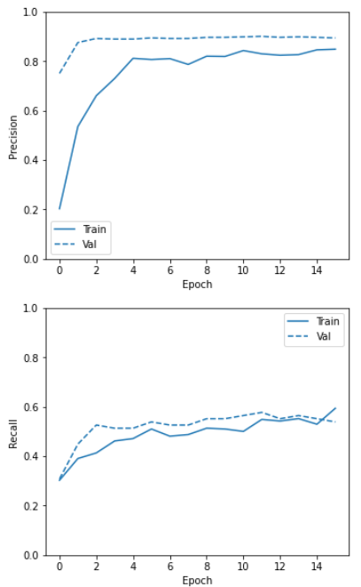
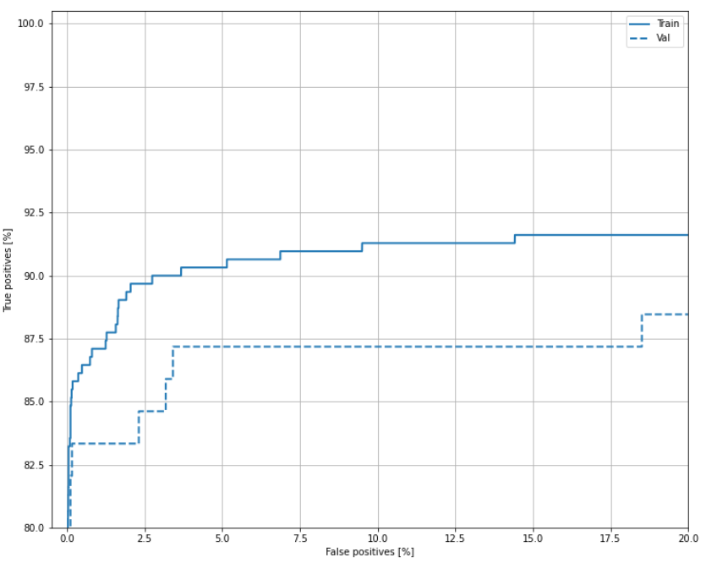
Baseline model: Cross Validation

Slide 16
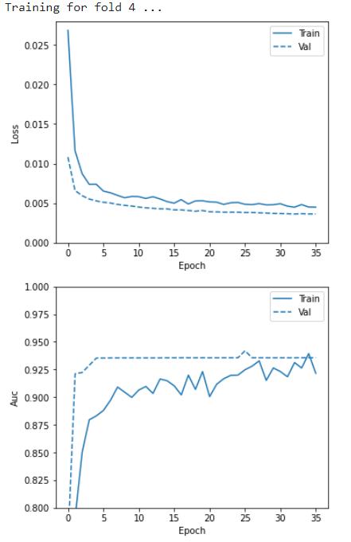
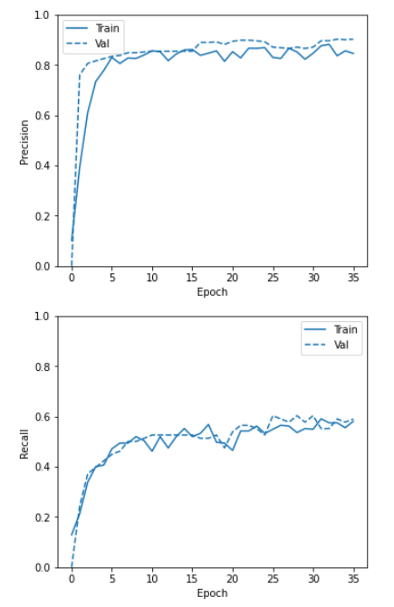
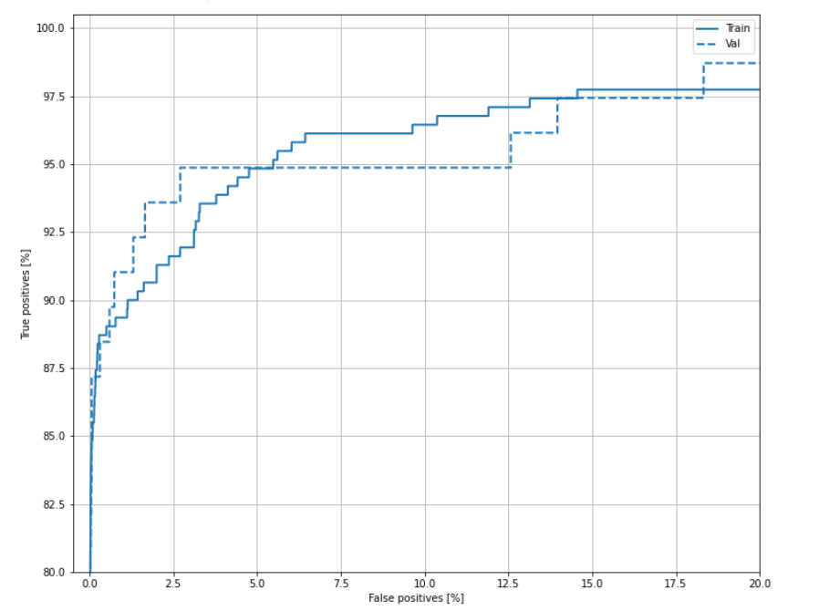
Baseline model: Cross Validation

Slide 17
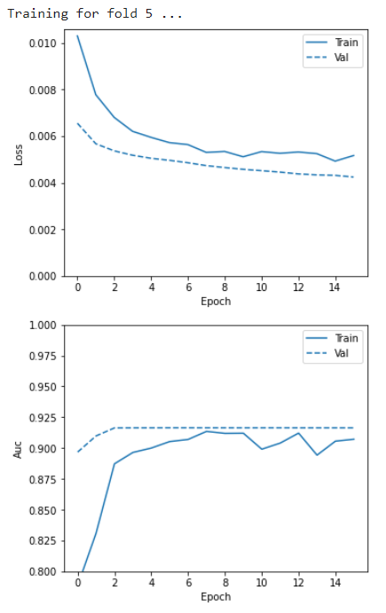
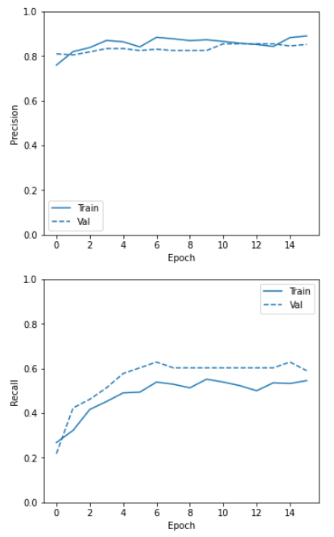
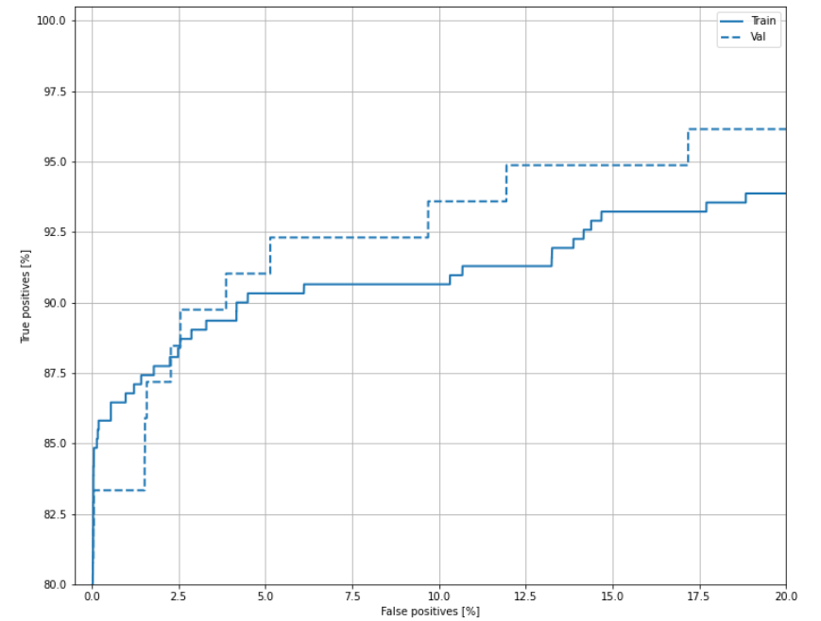
Baseline model: Cross Validation

Slide 18
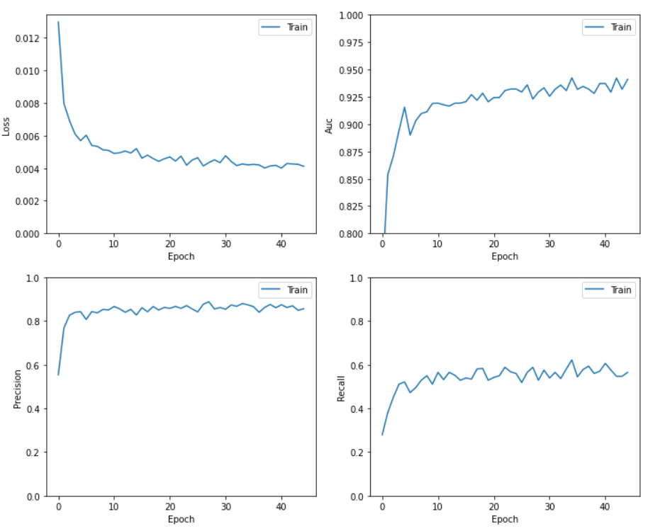
Baseline model: Training
Training:
Accuracy : 0.999
Precision : 0.888
Recall : 0.592
AUC : 0.942
Cross-Validation:
Accuracy: 0.999 +/- 4.25e-05
Precision: 0.871 +/- 0.0328
Recall: 0.582 +/- 0.0234
AUC: 0.929 +/- 0.0113

Slide 19
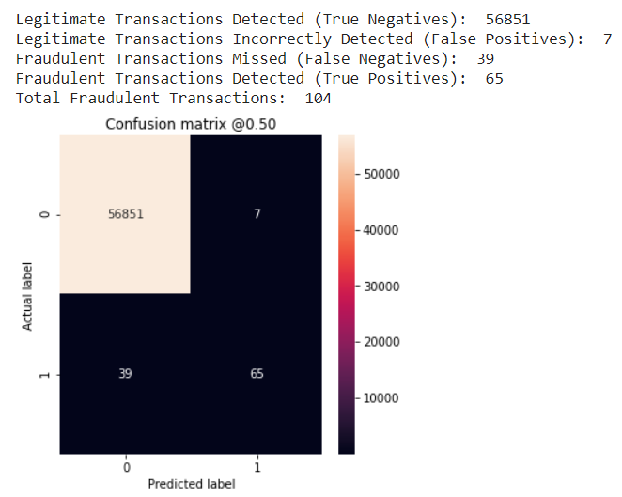
Baseline model: Test
Training:
Accuracy : 0.999
Precision : 0.888
Recall : 0.592
AUC : 0.942
Test:
Accuracy: 0.999
Precision: 0.903
Recall: 0.625
AUC: 0.932

Slide 20
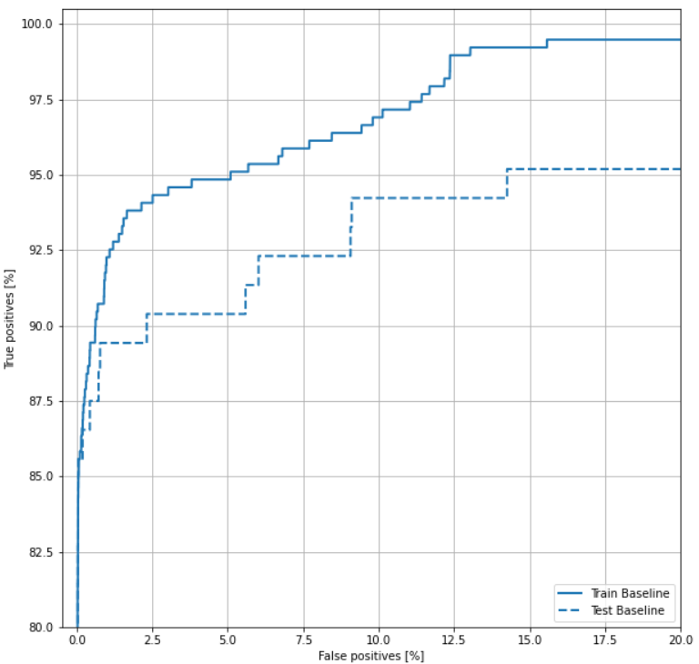
Baseline model: ROC Curve

Slide 21
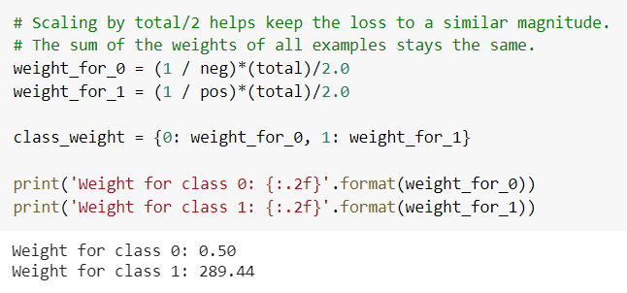
Weighted model

Slide 22
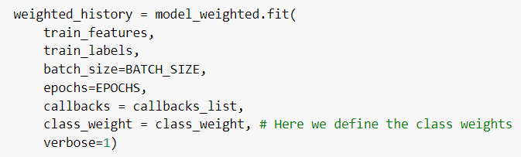
Weighted model

Slide 23
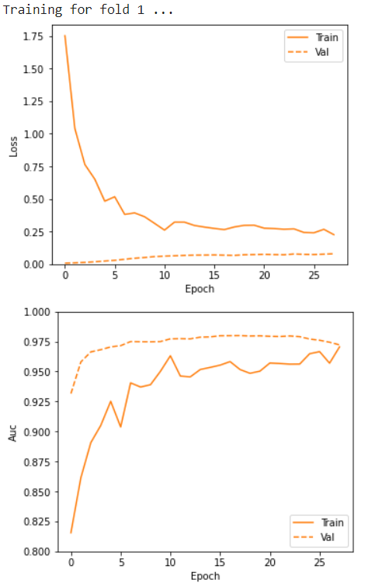
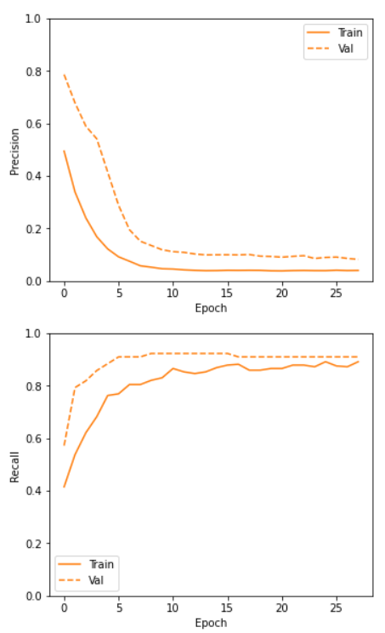
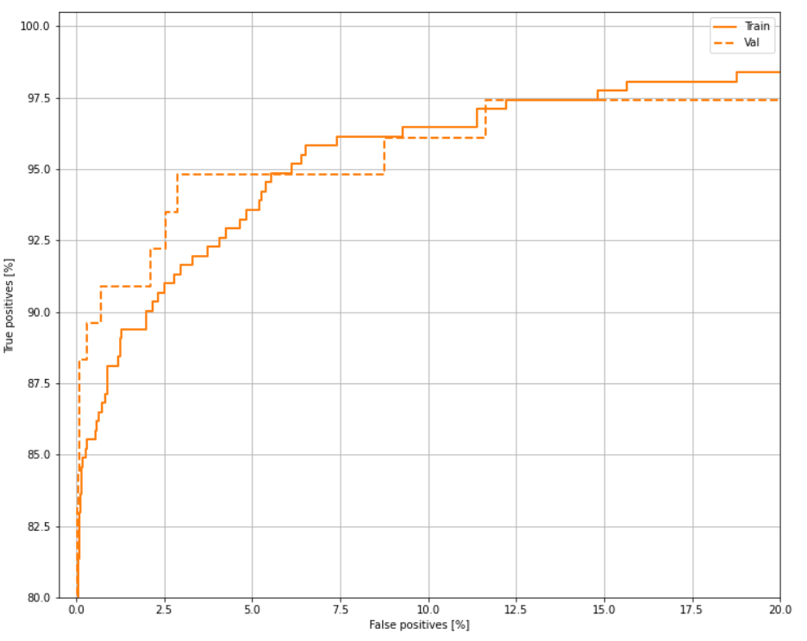
Weighted model: Cross Validation

Slide 24
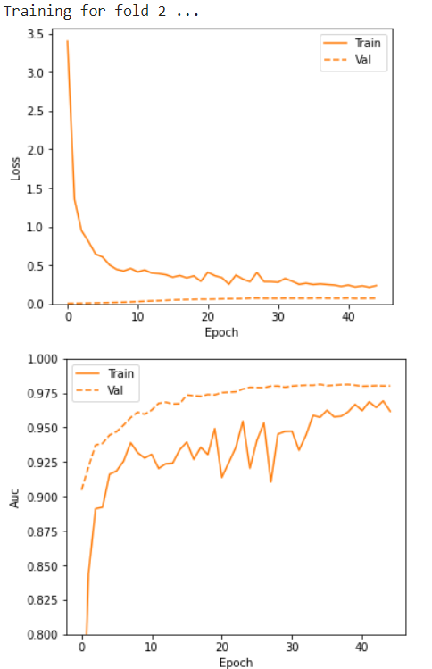
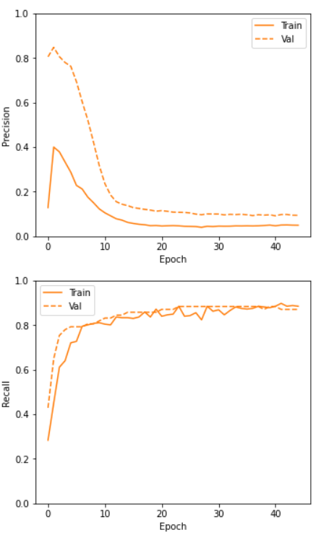
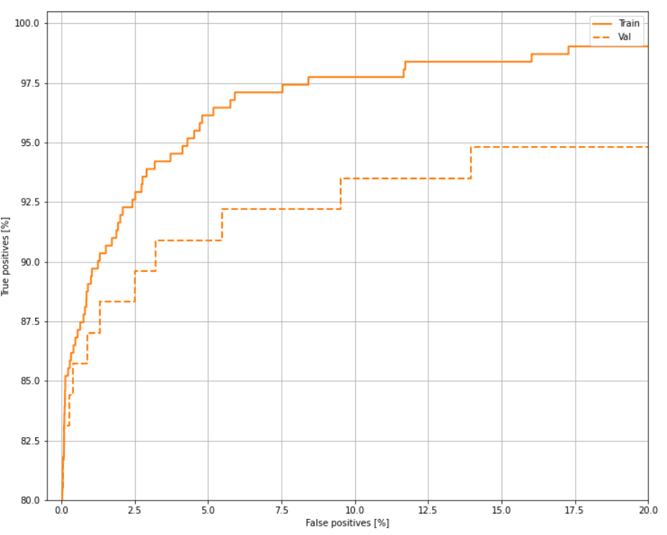
Weighted model: Cross Validation

Slide 25
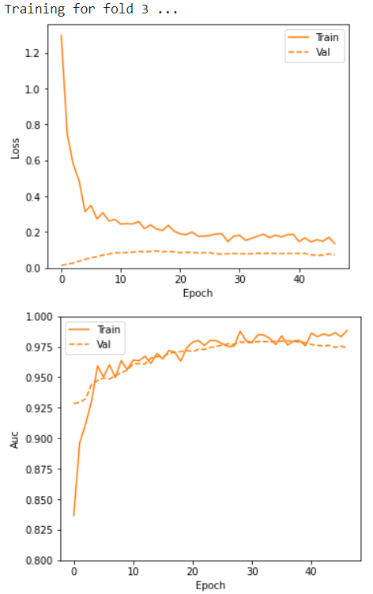
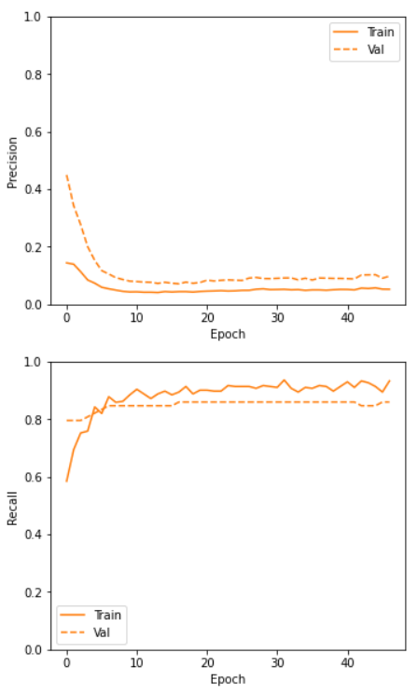
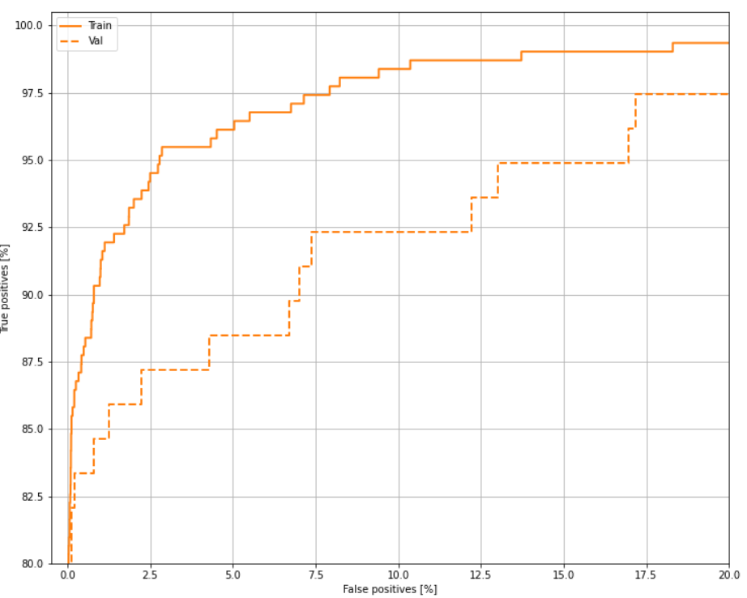
Weighted model: Cross Validation

Slide 26
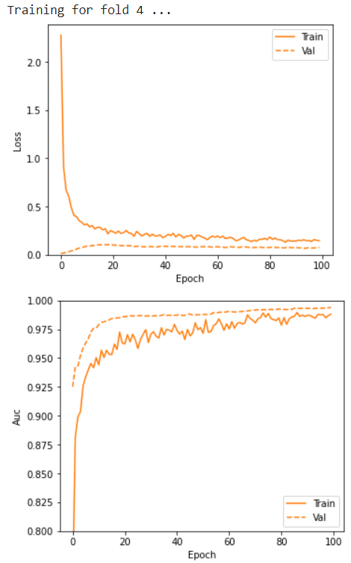
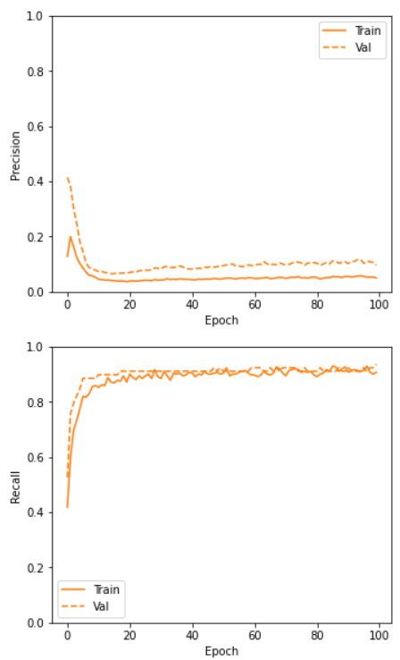
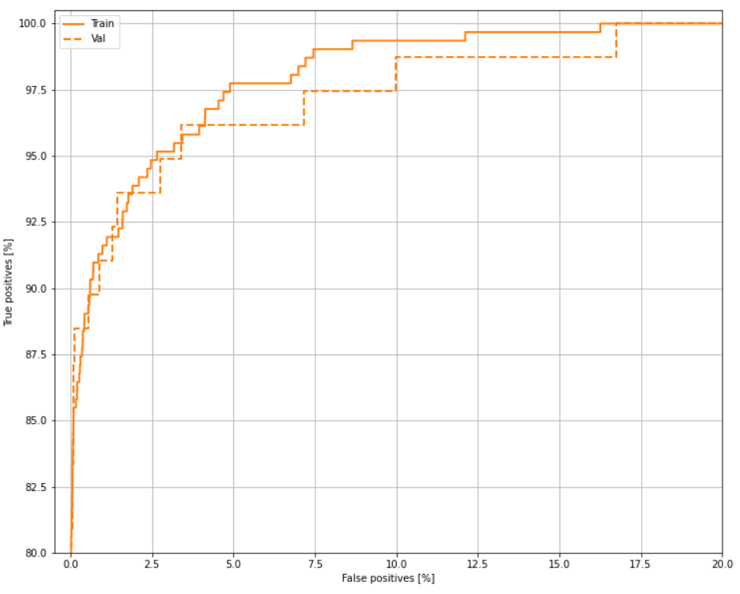
Weighted model: Cross Validation

Slide 27
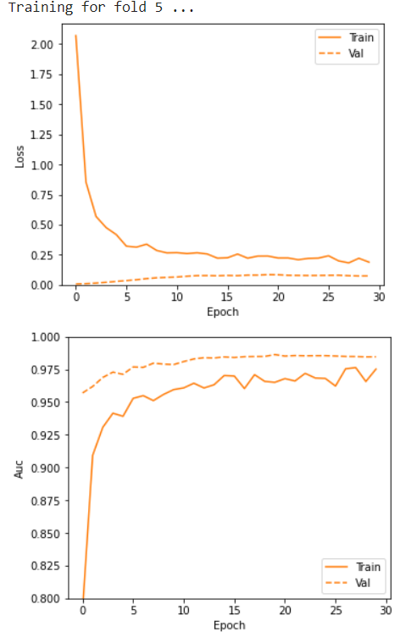
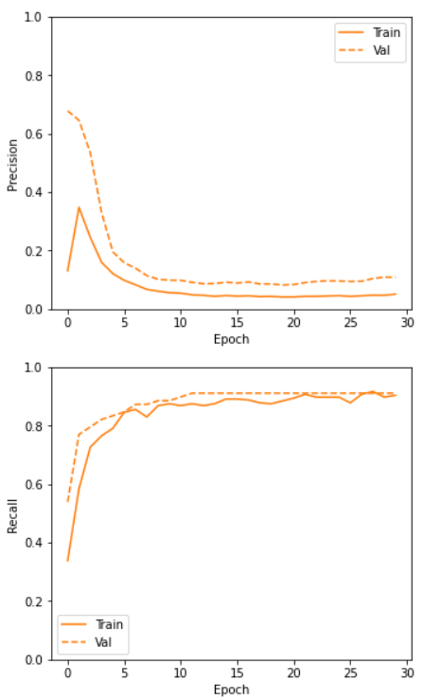
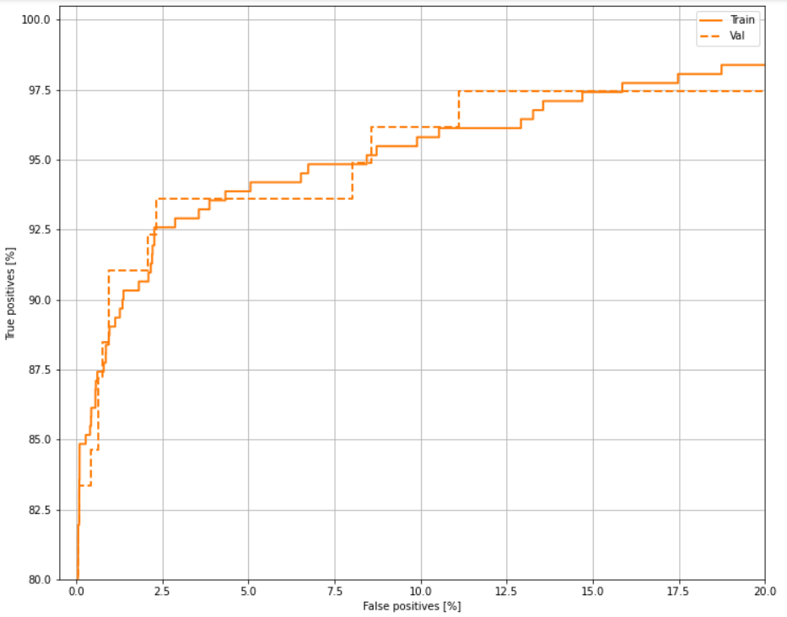
Weighted model: Cross Validation

Slide 28
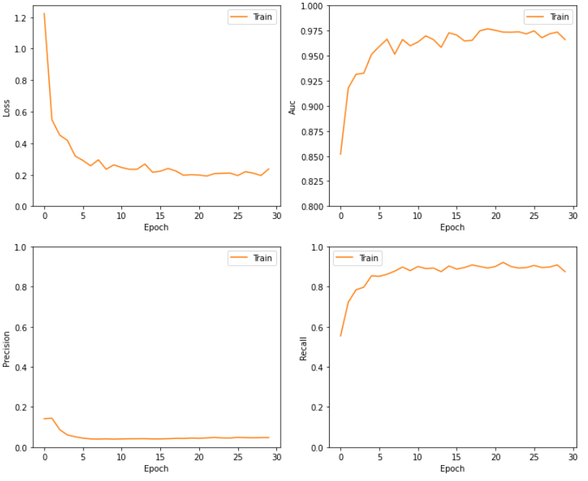
Weighted model: Training
Training:
Accuracy : 0.982
Precision : 0.0807
Recall : 0.9123
AUC : 0.987
Cross-Validation:
Accuracy: 0.985 +/- 0.00138
Precision: 0.0938 +/- 0.00670
Recall: 0.899 +/- 0.0262
AUC: 0.984 +/- 0.00535

Slide 29
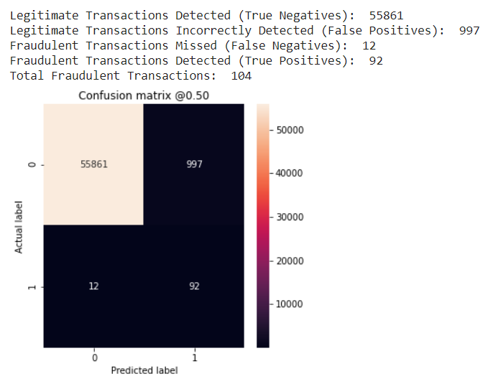
Weighted model: Test
Training:
Accuracy : 0.982
Precision : 0.0807
Recall : 0.9123
AUC : 0.987
Test:
Accuracy: 0.982
Precision: 0.0845
Recall: 0.885
AUC: 0.983

Slide 30
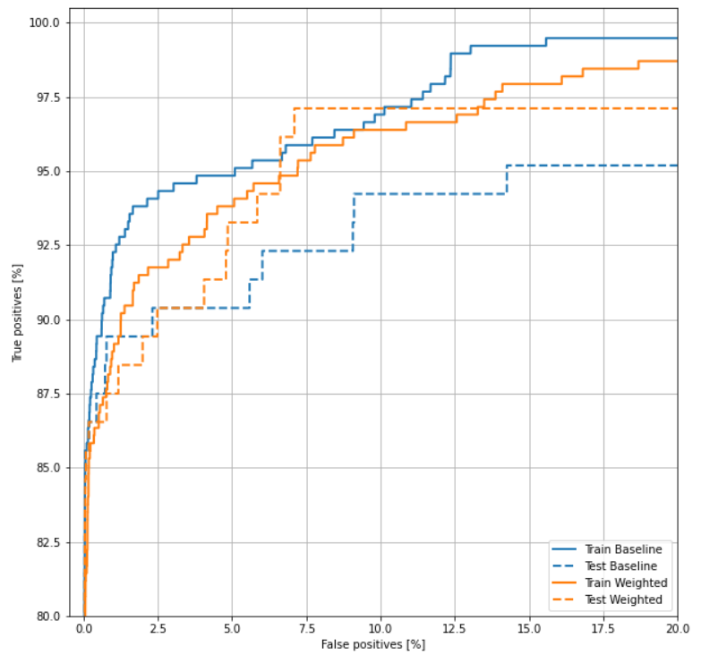
Weighted model: ROC Curve

Slide 31
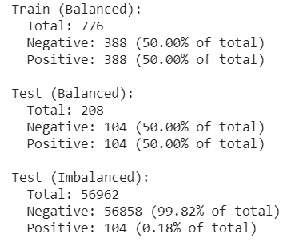
Undersampling

Slide 32



Undersampling: Cross Validation

Slide 33



Undersampling: Cross Validation

Slide 34



Undersampling: Cross Validation

Slide 35



Undersampling: Cross Validation

Slide 36



Undersampling: Cross Validation

Slide 37

Undersampling: Training
Training:
Accuracy: 0.917
Precision: 0.991
Recall: 0.843
AUC: 0.978
Cross-Validation:
Accuracy: 0.938 +/- 0.00963
Precision: 0.973 +/- 0.0218
Recall: 0.902 +/- 0.0280
AUC: 0.981 +/- 0.00132

Slide 38

Undersampling: Test (Balanced)
Training:
Accuracy: 0.917
Precision: 0.991
Recall: 0.843
AUC: 0.978
Test:
Accuracy: 0.923
Precision: 0.978
Recall: 0.865
AUC: 0.960

Slide 39

Undersampling: ROC Curve (Balanced)

Slide 40

Undersampling: Test (Imbalanced)
Training:
Accuracy: 0.917
Precision: 0.991
Recall: 0.843
AUC: 0.978
Test:
Accuracy: 0.140
Precision: 0.00212
Recall: 1.0
AUC: 0.970

Slide 41

Undersampling: ROC Curve (Imbalanced)

Slide 42
Conclusion
Test Baseline
Test Weighted
Test Undersampling

Slide 43
Conclusion
The baseline model has a good precision, but it fails in classifying most of the positive samples, which is a bad thing given the context of the problem. This approach has high precision, but average recall.
The weighted model classifies many legitimate transactions as fraudulent, but it is capable of catching most of the true positives. So here we have high recall, with low precision.
The undersample approach has high precision and recall when applied to a balanced dataset, but classifies a very large number of legitimate transactions as fraudulent when applied to the imbalanced dataset.
Final verdict: The weighted model is probably the best approach to this problem.

Slide 44

Batch Normalization: Not a good idea...

Slide 45


Batch Normalization

Slide 46


Batch Normalization

Slide 47

Batch Normalization

Slide 48


Batch Normalization
Train (Weighted)
Test (Weighted)

Slide 49

Deeper Network

Slide 50



Deeper Network

Slide 51

Deeper Network

Slide 52

“Excellent!”

